Slide 1
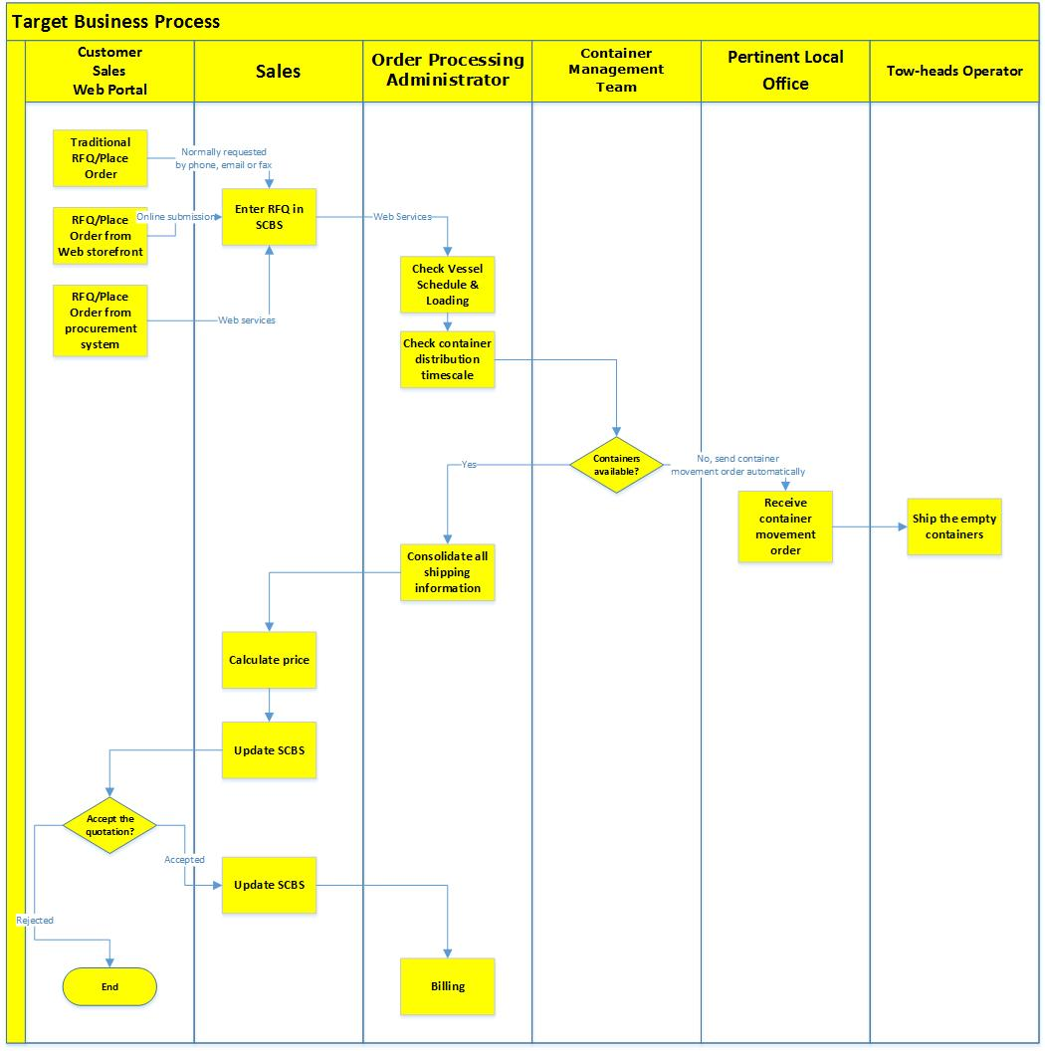
Phase 3
Phase 2
Phase 1

Slide 2
Phase 1
Phase 2

Slide 3
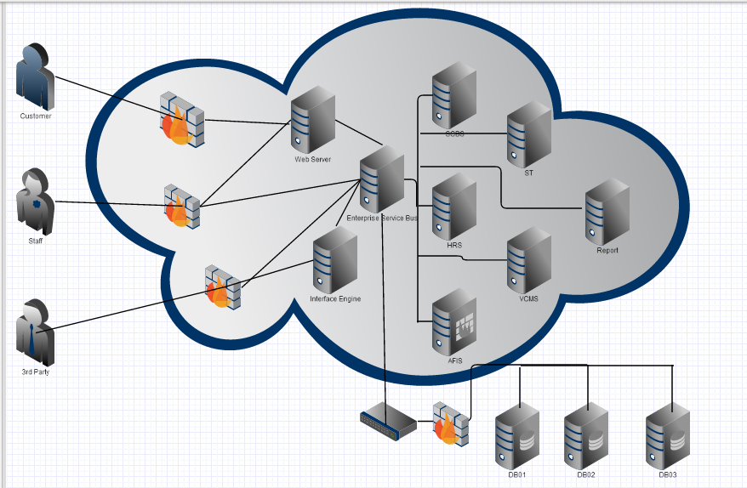
Phase 1
Phase 2
(Logical)
Phase 3
(Existing)
Phase 2
(Logical)
Phase 1

Slide 4
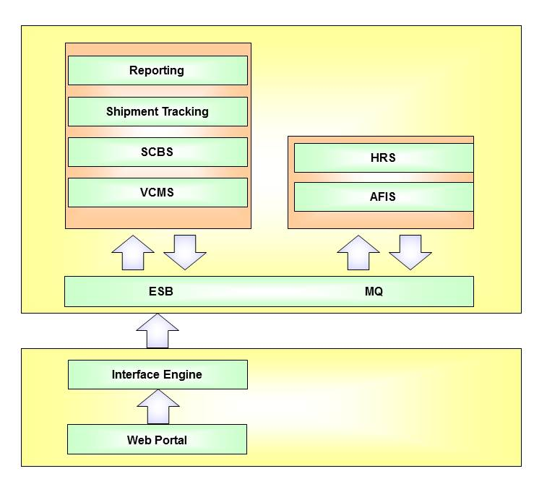
Phase 2
Phase 3
Phase 1

Slide 5
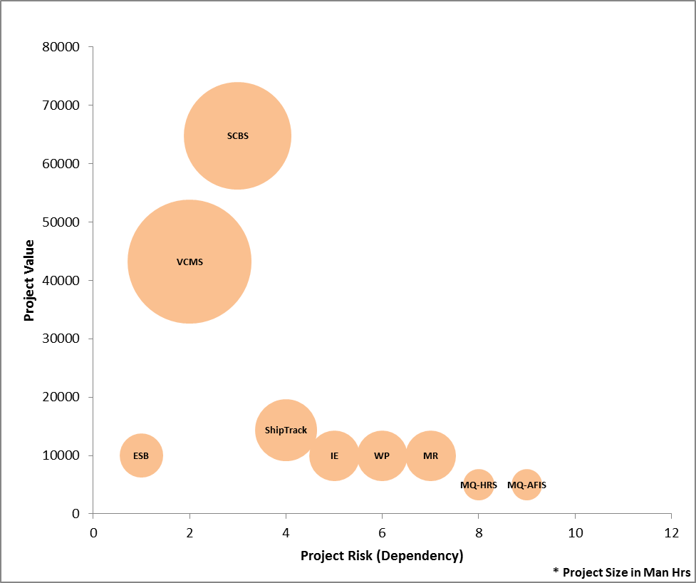
 | Projects | Ownership
Phase 1 | ESB | IT/Operations
 | VCMS | Container Management Team
 | IE | IT/Operations
 | Web portal | Container Management Team
 | Reports | Container Management Team
Phase 2 | SCBS | Order Processing Team
 | ShipTrack | Order Processing Team
 | IE | IT/Operations
 | Web portal | Order Processing Team
 | Reports | Order Processing Team
Phase 3 | MQ HRS | HR & Finance Team
 | MQ AFIS | HR & Finance Team
 | IE | IT/Operations
 | Web portal | HR & Finance Team
 | Reports | HR & Finance Team

